Slide 1


National Document Managent Syatem Project Overview
Presenter: G-2

Slide 2

Table of contents
01
02
03
Overview
Features and Functionalities
Security and Privacy
04
05
06
FAQs
Benefits of NDMS
Future Developments
07
Conclusion

Slide 3



01
Overview
0 1

Slide 4

Problem statement
The National Document Management System (NDMS) is an online portal that provides document management services to individuals and government organizations on a national level.
0 2

Slide 5
Overview NDMS
The National Document Management System (NDMS) is a government-wide initiative to provide a single, secure, and efficient way for government agencies to manage their documents. The NDMS is built on a DBMS platform and offers a number of features, including:
Document storage
Document organization
Document View
Document Delete
0 3

Slide 6


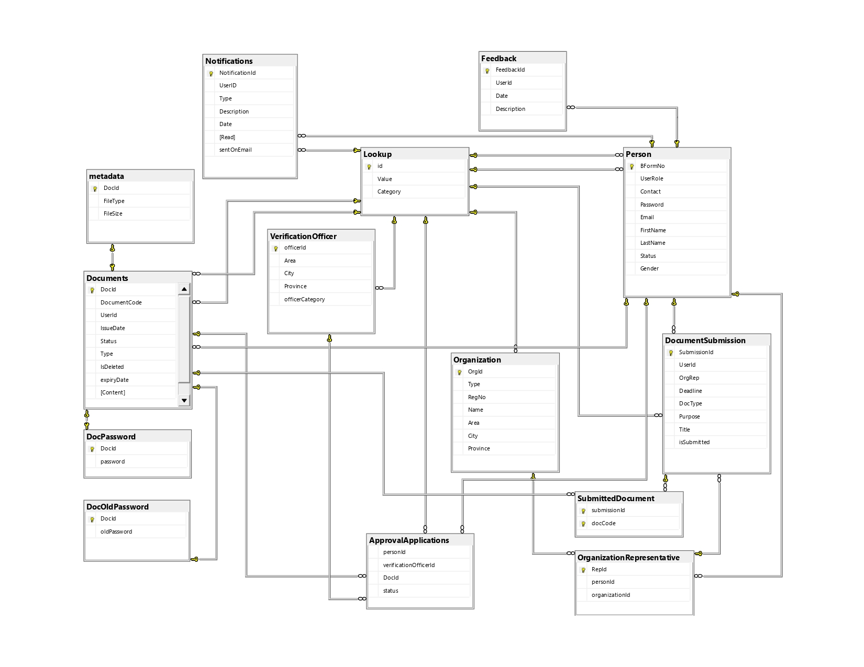
Dataset Architecture
Database Design
The data is to be handled on SQL Server Database. A concrete understanding of the database structure was provided. The data set composes of many tables/relations in order to reduce database anomalies, proving to be a normalized database design.
0 4

Slide 7
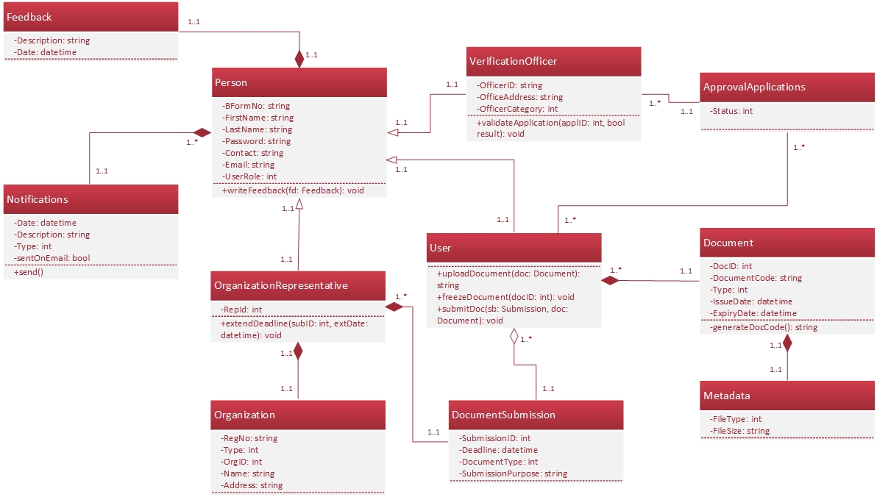
Dataset Architecture
Class Diagram
A class diagram in PHP is a visual representation of classes, their attributes, methods, and relationships. It helps to understand the structure of a system. Classes are blueprints for creating objects that share common properties and methods.
0 5

Slide 8


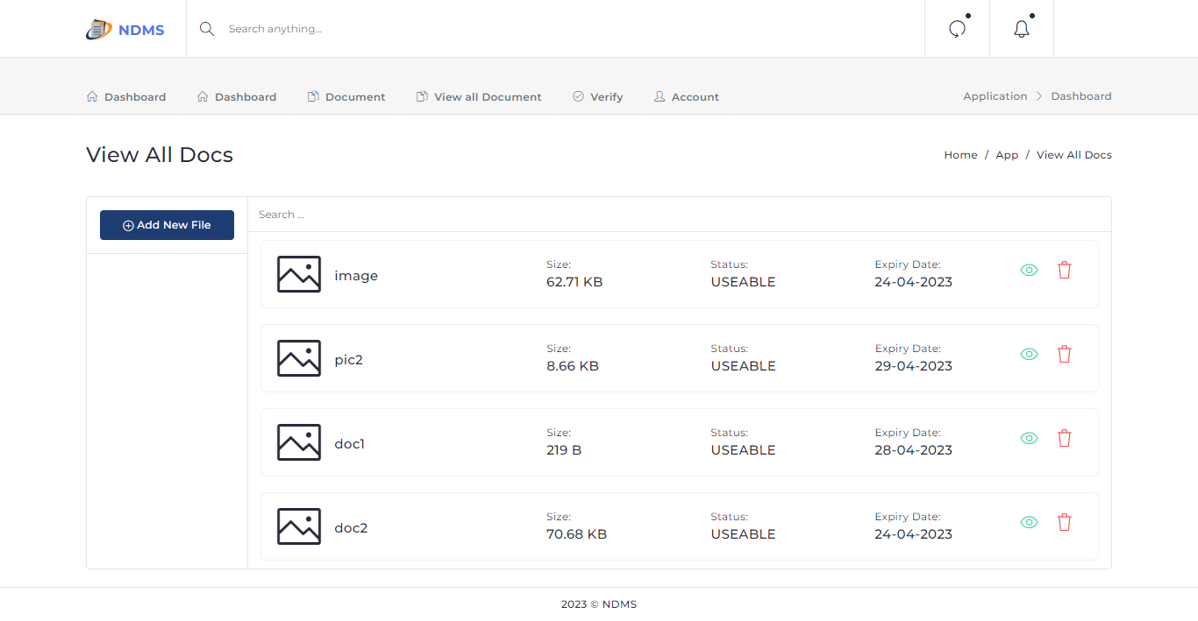
Proposed solution
An application created using PHP and Web Technology.
It implemeents all required functionalities such as CRUD operations on basic entities (Document, User, Verification officer and etc.).
0 6

Slide 9



Our Solution
Upload and manage documents efficiently and precisely
0 7

Slide 10
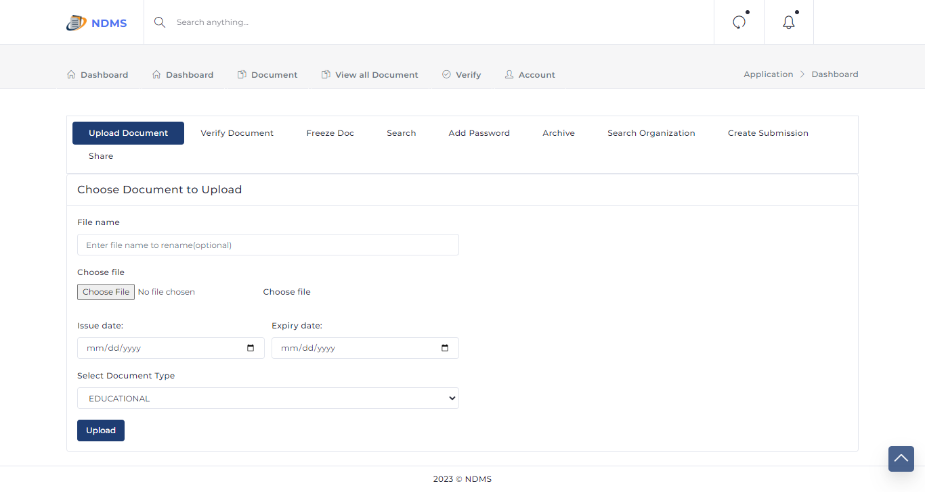
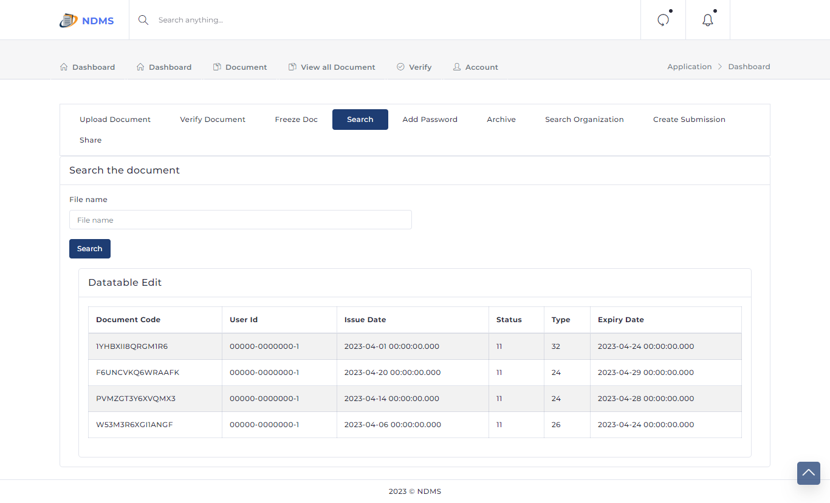

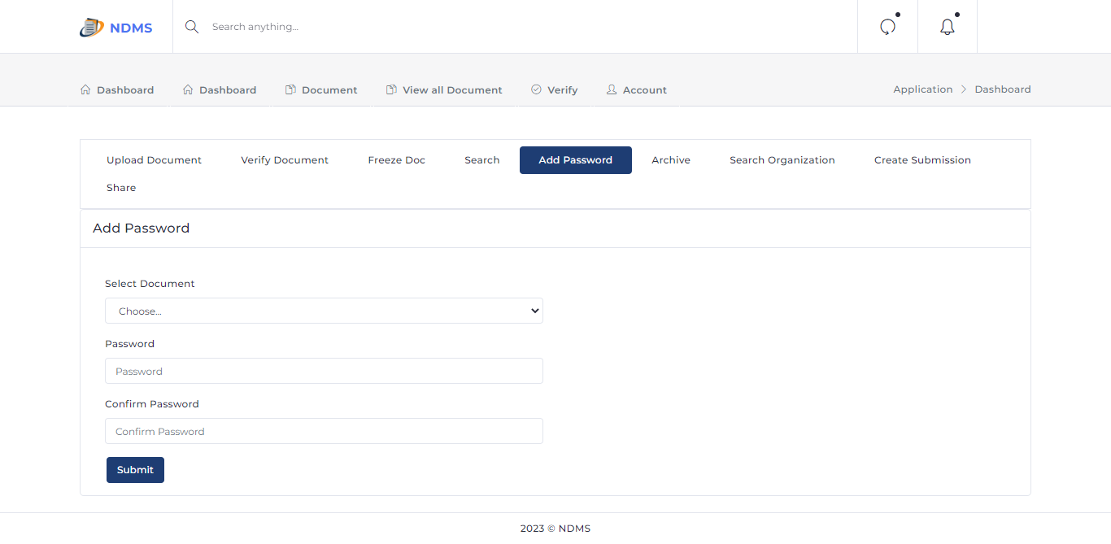
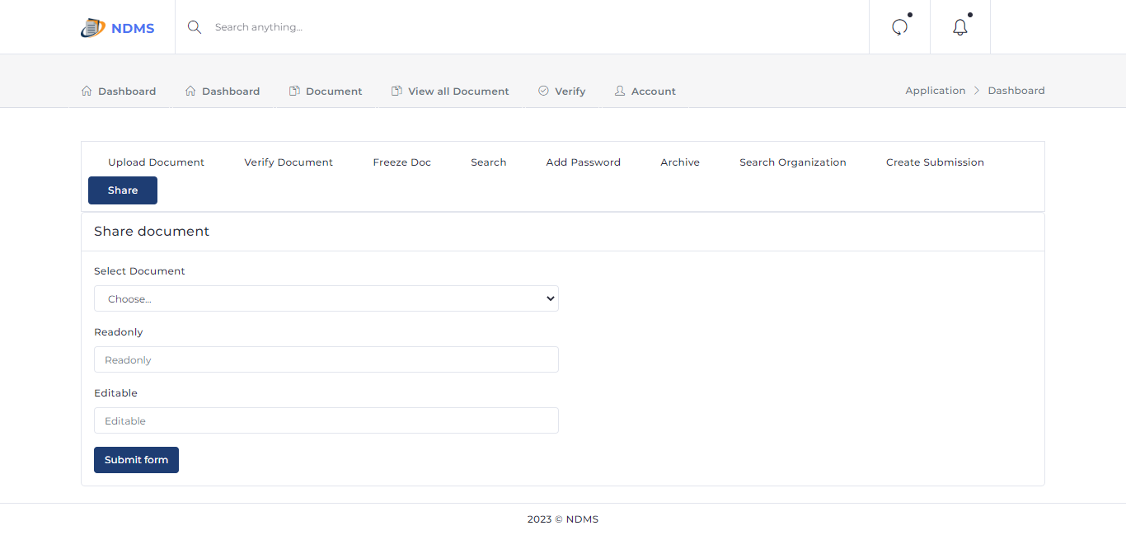
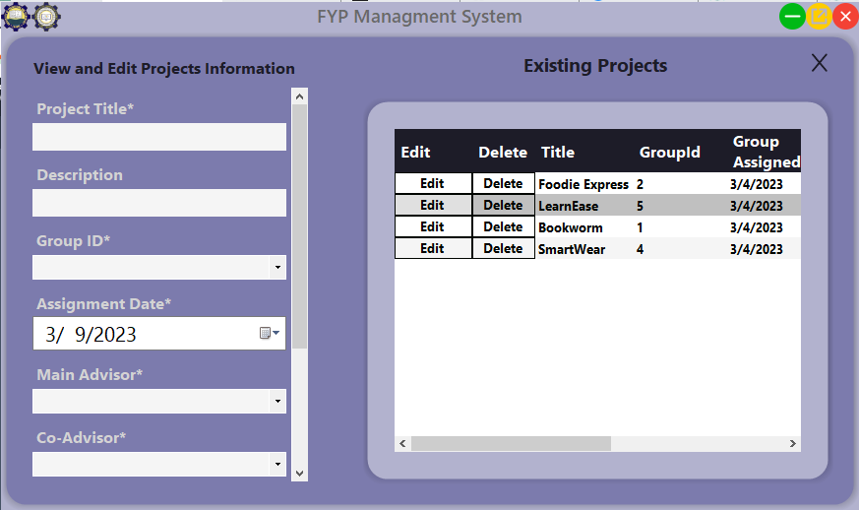
UI of NDMS
0 8

Slide 11

02
Features and Functionalities
The key features and functionalities of the system
0 9

Slide 12


Features Functionalities
User registration and authentication
Document upload
Reporting and analytics
Document management
1 0

Slide 13
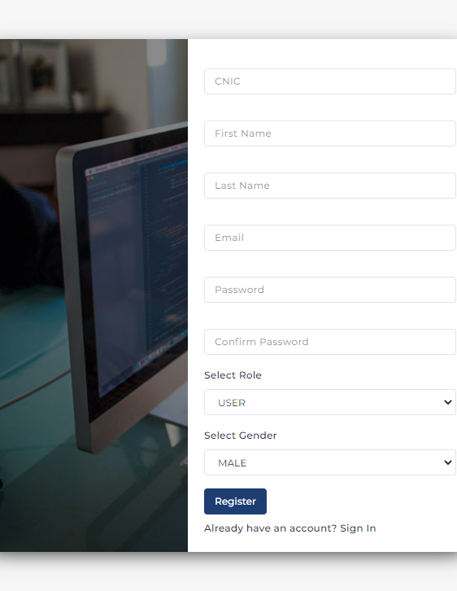
User registration and authentication
User can easily register by using registration page
1 1

Slide 14
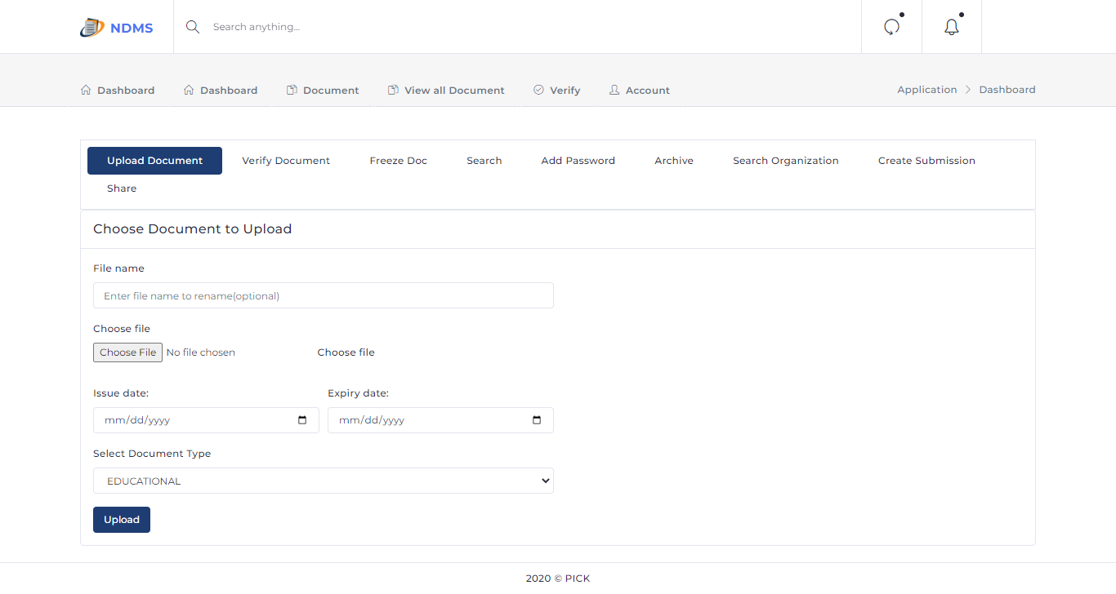
Document upload
User can upload documents
1 2

Slide 15
Document management
User can view and delete document
1 3

Slide 16
03
Security and Privacy
$
Some Security and Privacy of a National Document Management System (NDMS)
1 4

Slide 17

Your Privacy
Encryption
User authentication
NDMS protect users passwords
No false user can access others document without authentication
1 5

Slide 18

Benefits of NDMS
04
The NDMS offers a number of benefits for government agencies, including
1 6

Slide 19

Benefits of NDMS
NDMS
Increased efficiency
Improved security
Reduced costs
save time
Secure access and share of document
Elimination cost of papers
1 7

Slide 20
05
Future Developments
1 8

Slide 21
Future Developments
Integration with blockchain technology
Improved AI capabilities
Data analytics and reporting
Mobile app development
1 9

Slide 22

06
FAQs
2 0

Slide 23


FAQs
Question
What types of documents can I store in the NDMS?
Answer
You can store any type of document in the NDMS, including:
Pdf
Image
Txt
2 1

Slide 24
FAQs
Question
How do I freeze documents?
Answer
You can freeze document by just going to document section then go to freeze document subsection. Now you have to select document and click freeze button.
2 2

Slide 25
Conclusion
07
2 3

Slide 26
Conclusion
In conclusion, the National Document Management System (NDMS) provides numerous benefits for individuals and organizations.
The system streamlines document management processes, reduces costs associated with paper-based systems, and improves data security.
However, the implementation of an NDMS can present challenges such as user adoption, data security and privacy concerns, and integration with existing systems.
Looking ahead, future developments in NDMS technology such as improved AI capabilities, integration with emerging technologies, and mobile app development could further enhance the system's functionality and value.
By addressing these challenges and embracing new developments, NDMS has the potential to revolutionize document management and transform the way we manage and access our documents.
2 4

Slide 27

Our Hardworking & Dedicated Team
2 5

Slide 28


Our team
Safi ullah
Passionate to work
Usman Farid
Great Developer
2 6

Slide 29


Our team
Waqas Rashid
Extraordinary worker and developer
Muhammad Farman
Great Developer
2 7

Slide 30
Thank you!

